Slide 1
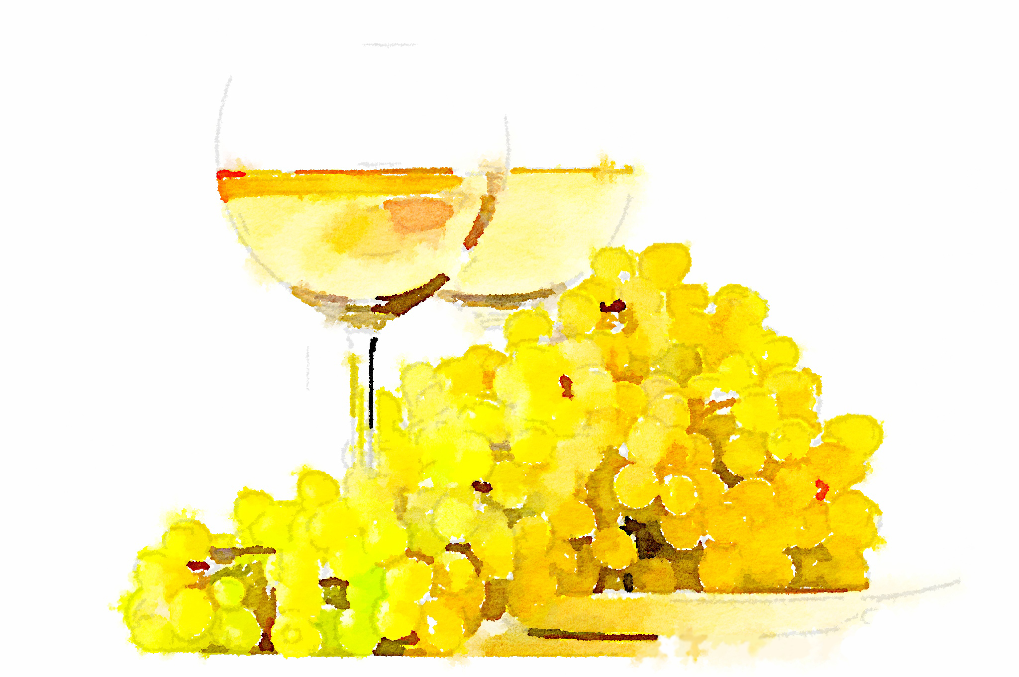
White Wine Quality
White Wine Quality
Group Members:
Qing Dong
Yuying Chen
Yi Jiang
Mengtian Song
Wenxin Liang

Slide 2

Background & Objective
White wine is increasing enjoyed by a wider range of consumers when we view luxury goods

Slide 3
Data Source

Slide 4
Methodology

Slide 5
Initial Results

Slide 6
Future Study

Slide 7
Q & A

Slide 8
Thanks for watching

